Slide 1
Java 8 – SE 1 Presentation
Chapter 6 – Exceptions

Slide 2
Previous questions leftover
Question about the polymorphism + overriding method
Answer: According to the book, page 285, it said that at the ... time, the ...class only knows about its ... version of the method => (link to the access modifier and exception example) => The ... version will only be ... at ... time
– However, with the ... type question, it is better to consider it as ... (because it relevant to a much more advanced topic called ... type – linked to mathematic topic) => better not to dig deeper into the topic

Slide 3
Understanding Exceptions – The role of exception
- Exception is the way Java told us: "..., you try to .... it"
- When we write a ..., we can ... or ...
- In Java, there are ... ways to ... the exception:
+)
+)
(code illustration snippet 1)
- Exception happens ... (even if our code is ... ). When we write the code at higher ..., we have to deal with ... exceptions such as ..., .... (At OCA level, we will just study about the type of Exception that relevant to ...)
- A keypoint need to remember is: Exception alter ... ?
Return codes VS Exception
- Exception is used in ..., however the word "..." here is albeit controversial
(code illustration snippet 2)
- As we can see, the code ... "-1" instead of an Exception if there is ... This is a common ... in some methods that has ... purposes (For example, we need to find a String "Joe" in an ... => it is absolutely normal for "Joe" to ... => a special ... will be ...)
- Exception should be retained for ...

Slide 4
Understanding Exceptions – The role of exception
- In general, ... should be avoided because ... is always used in ... with ... purpose => Most developers will expect it => We can make them ... if we use ... in other method.
- An exception forces ... while ... could be ignored => If ignored => ?

Slide 5
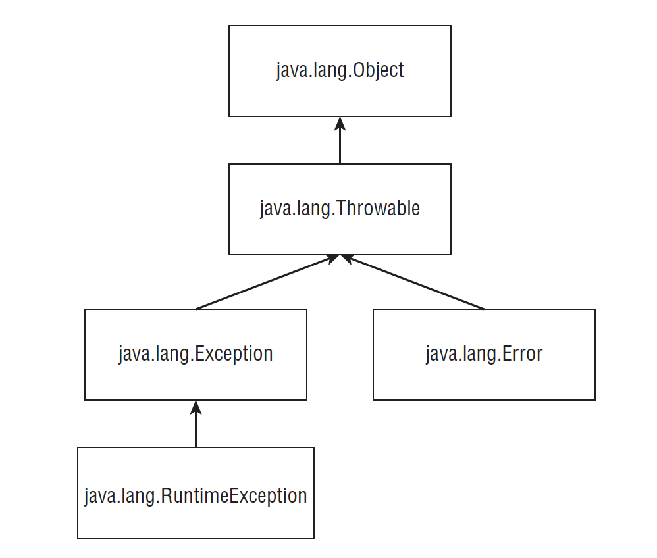
Understanding Exceptions – Understanding Exception type
- As I discuss before, Exception is an ... that alter ... => Java has a ... class called ... that represent all ... like that (not all of them ... name ...)

Slide 6
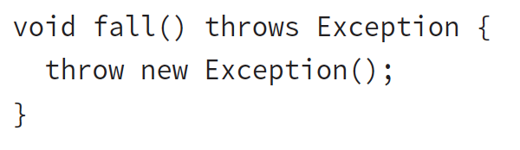
Understanding Exceptions – Understanding Exception type
- Error is something ... happened (normally these ... affect ... JVM) (for example: a ... drive ... ed)
- RuntimeExeption is defined as a ... itself or its ... class. RuntimeException is ...able (but not completely ... that affect ...) (For example: accessing ... array ...)
Runtime VS at the time the program is run
- Runtime (or sometime referred as ...) is a type of ... that runs when ... is run (the alternative is ... time, which runs on ... time {some time referred as ...}). However, they don't refer it as "run-time exception" because it will be easy ... with ...
- ... Exception is a type of exception that has superclass of ... or ... (... exception is easier to anticipate) (For example: reading a non ....)
- Checked Exception need to be ... "throws" or ... (this is a rule in Java called "... or ... rule")
– Explain the difference between "throw" and "throws"

Slide 7
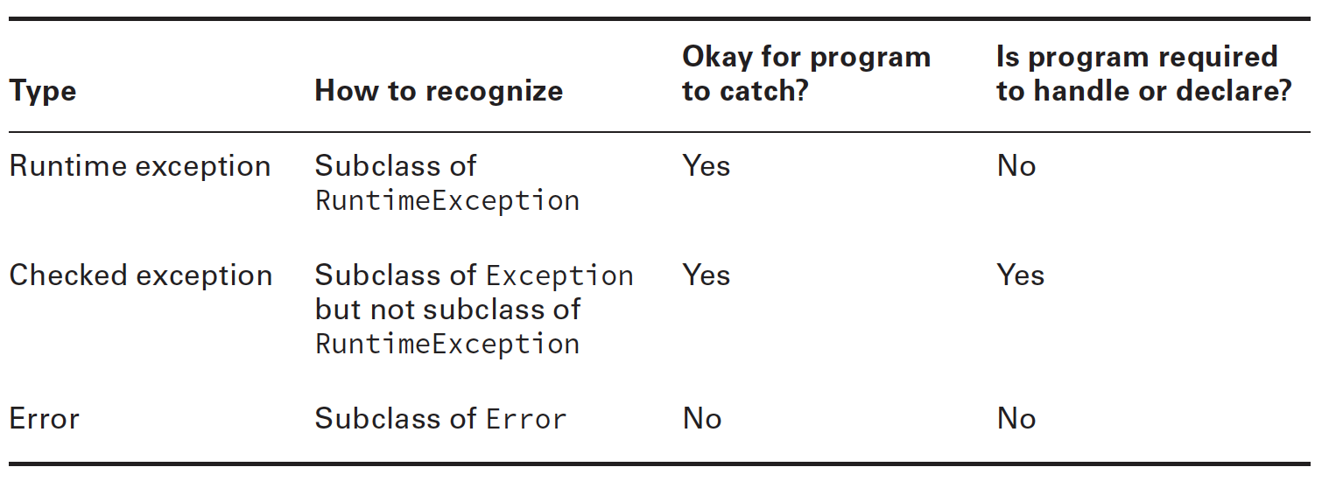


Understanding Exceptions – Throwing an exception
- There are ... types of throw:
+)
+)
(code illustration snippet 3 – 4)
- Usually, when we use "active ...", we will pass a String ... that contains .... into the constructor
– We said "usually" because this is a ... (some people might not ...)

Slide 8
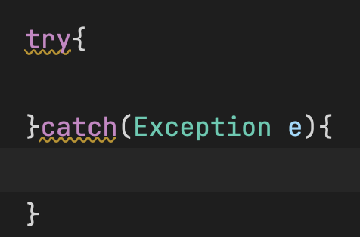
Using a "try" statement
(Note: try ... and try ... is different, try ... contains ... and ...)
(explain each of the component below)
(Additional: What is another name of the try block ?)
(code illustration snipppet 5 – 6 – 7 – 8)

Slide 9
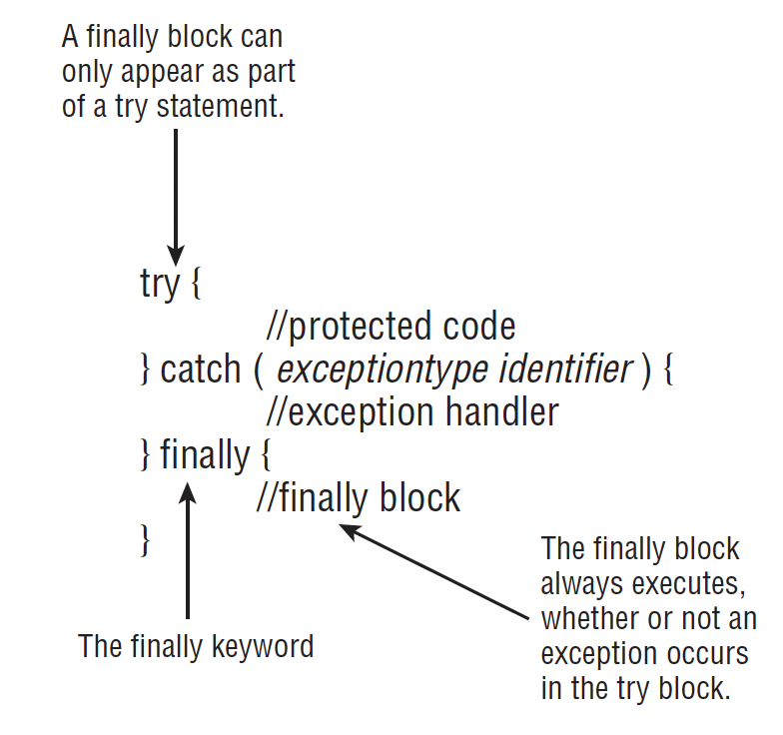



Using a "try" statement – adding a finally block
- "Try" block allows us to ... after ... (no matter exception are ...)

Slide 10
Using a "try" statement – adding a finally block
- On OCA exam, we have to know that "try" must have ... or ... (on OCP exam, we will study other type of "try", which is called "..." that doesn't need ....)
(code illustration 9 – 10 – 11 – 12 – 13)
System.exit(?)
- There is only one case where ... won't ..., which is System.exit(?). The parameter is ... code (ask question Q1)
- System.exit(?) is like "... stop ....". When System.exit(?) is called in ... or ... => "..." won't run

Slide 11
Using a "try" statement – Catching various types of exception
- So far, we are just working with ... catching ... => What happen if we ... multiple ...
– In OCA exam, we won't discuss about ... exception (that will be in OCP exam), right now we just need to know this:
+) ... whether the exception is .... or ...
+) ... whther the exception is ... class of ...
(code illustration snippet 14 – 15)
- Java will read try-catch in ...
– If there are any catch blocks that is ....able => ... will complain
- This happen because the upper ... has already ... => the bottom ... (snippet 14 has swappable ... because it doesn't has ...)
(code illustration snippet 16 – 17 – 18)

Slide 12
Using a "try" statement – throwing a second exception
- So far, we just working with ... try-catch-finally. However, in try-catch-finally, we can put ... => which mean we can also put ...
(code illustration snippet 19)
- However, there are some weird cases
(code illustration snippet 20)
(Note: There is a ... stated in Java ... about the try-catch and try-catch-finally ...) (link note 1-2)
(code illustration snippet 21)
Notes:
Note 1: https://docs.oracle.com/javase/specs/jls/se8/html/jls-14.html#jls-14.20.1:~:text=%C2%A714.20.3).-,14.20.1.%C2%A0Execution%20of%20try%2Dcatch,-A%20try%20statement Note 2: https://docs.oracle.com/javase/specs/jls/se8/html/jls-14.html#jls-14.20.1:~:text=Caught%20BlewIt-,14.20.2.%C2%A0Execution%20of%20try%2Dfinally%20and%20try%2Dcatch%2Dfinally,-A%20try%20statement

Slide 13
Recognizing common exception type
Arith...
Arr...
ClassCastException: This happen because ... cast... (code illustration snippet 22)
IllegalArgumentException: This happen because ... passing... (code illustration snippet 23)
Nul...
NumberFormatException: This happen because ... convert to ... object ... (code illustration snippet 24)
=> these are all categorized as ...
Notes:
Note 1: https://docs.oracle.com/javase/specs/jls/se8/html/jls-14.html#jls-14.20.1:~:text=%C2%A714.20.3).-,14.20.1.%C2%A0Execution%20of%20try%2Dcatch,-A%20try%20statement Note 2: https://docs.oracle.com/javase/specs/jls/se8/html/jls-14.html#jls-14.20.1:~:text=Caught%20BlewIt-,14.20.2.%C2%A0Execution%20of%20try%2Dfinally%20and%20try%2Dcatch%2Dfinally,-A%20try%20statement

Slide 14
Recognizing common exception type
FileNotFoundException: This one happen because ... refer ...
IOException: This one happen during ... file
=> These are categoized as ...
Notes:
Note 1: https://docs.oracle.com/javase/specs/jls/se8/html/jls-14.html#jls-14.20.1:~:text=%C2%A714.20.3).-,14.20.1.%C2%A0Execution%20of%20try%2Dcatch,-A%20try%20statement Note 2: https://docs.oracle.com/javase/specs/jls/se8/html/jls-14.html#jls-14.20.1:~:text=Caught%20BlewIt-,14.20.2.%C2%A0Execution%20of%20try%2Dfinally%20and%20try%2Dcatch%2Dfinally,-A%20try%20statement

Slide 15
Recognizing common exception type
ExceptionAtInitializerError: Java runs static ... during ... first .... If one of the static ... but we not ... it => Java can't start ... class => It complain by ...
(However, in order to reproduce this error, we must use ... throw instead of ... throw ..., we could try it too)
(code illustration snippet 25 – 26)
Stack...
NoClassDefFoundError: This happen because a class ... at ... time but not ... at ... time
(code illustration snippet 27 – 28)
Notes:
Note 1: https://docs.oracle.com/javase/specs/jls/se8/html/jls-14.html#jls-14.20.1:~:text=%C2%A714.20.3).-,14.20.1.%C2%A0Execution%20of%20try%2Dcatch,-A%20try%20statement Note 2: https://docs.oracle.com/javase/specs/jls/se8/html/jls-14.html#jls-14.20.1:~:text=Caught%20BlewIt-,14.20.2.%C2%A0Execution%20of%20try%2Dfinally%20and%20try%2Dcatch%2Dfinally,-A%20try%20statement

Slide 16
Calling methods that throw exceptions
(code illustration snippet 27 – 28 – 29)
- Java still ... for ...able code. Any method that doesn't ... ed exception that is present in a ... block and also ...with a ... block that ... the exception => Java will count it as ... code
(Note: We should read Java ... about the definition of ... code) (link note 3)
(code illustration snippet 30)
For subclasses (use polymorphism knowledge too)
(code illustration snippet 31 – 32 – 33 - 34)
Notes:
Note 3: https://docs.oracle.com/javase/specs/jls/se8/html/jls-14.html#jls-14.21:~:text=Either%20the%20type,it%20is%20reachable.)

Slide 17
Printing an exception
- There are ... ways to print exception in Java:
+)
+)
+)
(code illustration snippet 35)
- The first line it prints ...
- The second line it prints ...
- The third line it prints ...
- Stack trace is the most ... of them all because it shows us at which ..., which ... that ... exception that JVM has ....
- Stack trace shows all ... that are called in ...
- When an exception is ..., it will go through the ... to see if there are any ... that can ... the exception (if not then it just ...)
(ask question Q2, also requires verify of translated information that we just talk)
Notes:
Note 3: https://docs.oracle.com/javase/specs/jls/se8/html/jls-14.html#jls-14.21:~:text=Either%20the%20type,it%20is%20reachable.)

Slide 18
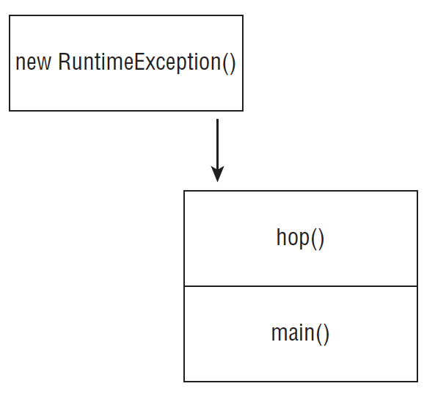
Printing an exception
Notes:
Note 3: https://docs.oracle.com/javase/specs/jls/se8/html/jls-14.html#jls-14.21:~:text=Either%20the%20type,it%20is%20reachable.)

Slide 19
Printing an exception
Why swallowing exception is bad
- Since ... exception requires us to ... or ..., we might be "temptated" to just ... the exception and not .... However, if we try to do that => ...
(code illustration snippet 36)
- When we ... code, please at least ... the ... trace or at least print ... any ... useful
– Also, we should also ... whether to .... continue or ...
Notes:
Note 3: https://docs.oracle.com/javase/specs/jls/se8/html/jls-14.html#jls-14.21:~:text=Either%20the%20type,it%20is%20reachable.)

